Slide 1
AI ın COMPUTER vısıon
By Synaps

Slide 2
What is Computer Vision
Computer vision is a field of artificial intelligence (AI) that enables computers and systems to derive meaningful information from digital images, videos, and other visual inputs.

Slide 3
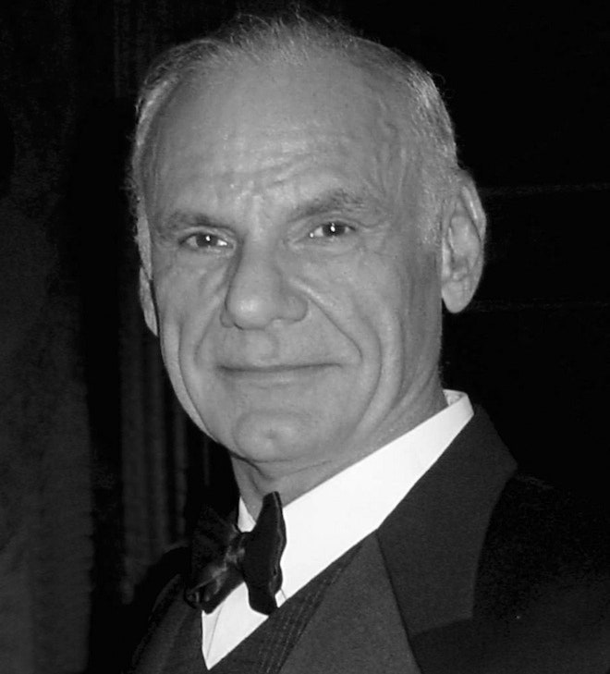
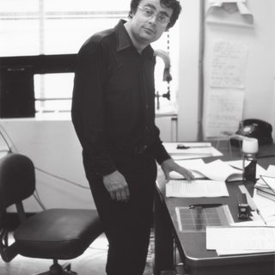
Pioneers of Computer Vision
Larry
Roberts
David
Marr

Slide 4
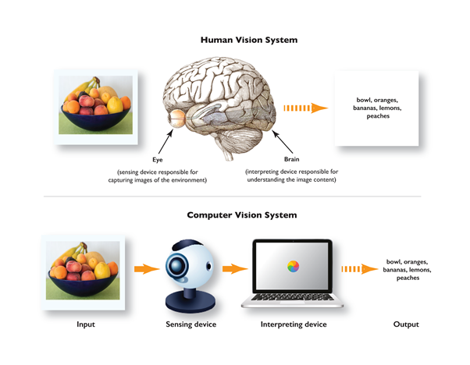
Human vs Computer Vision
Maybe humans can be better at differing images but we can’t do this rapidly and continuously.

Slide 5
Where Do We Use Computer Vision?
Transportation
Healthcare
Manufacturing
Construction
Agriculture
Retail
Military

Slide 6
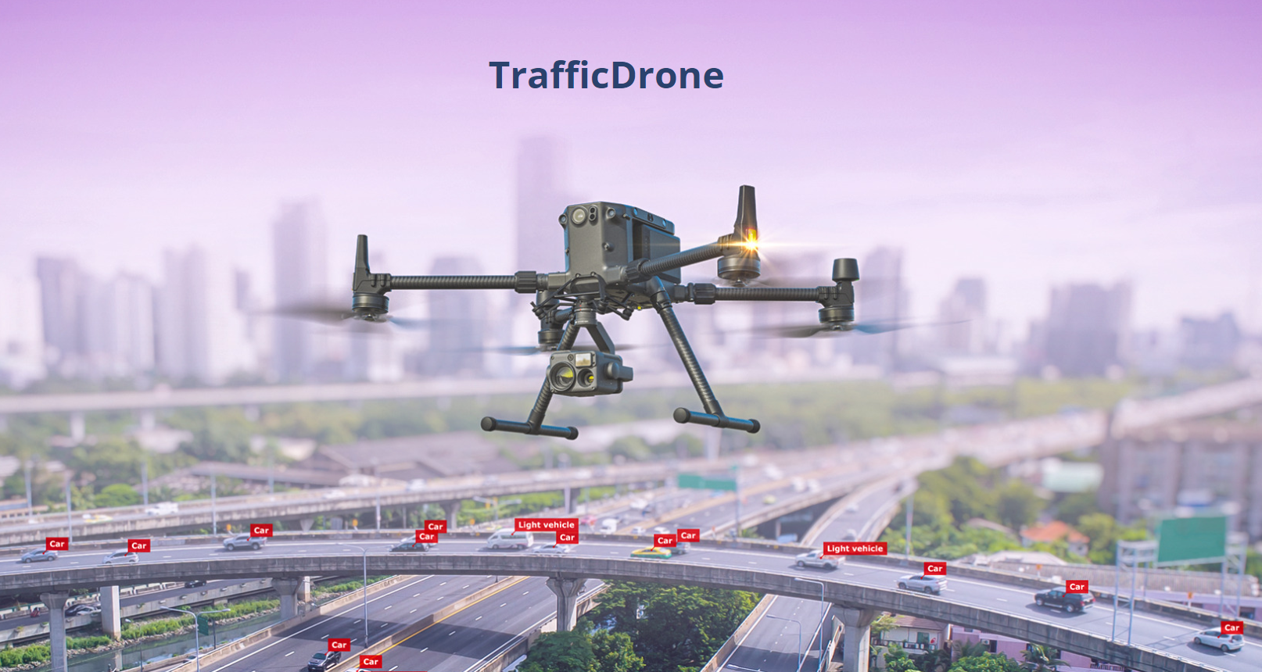
Traffic Drones

Slide 7
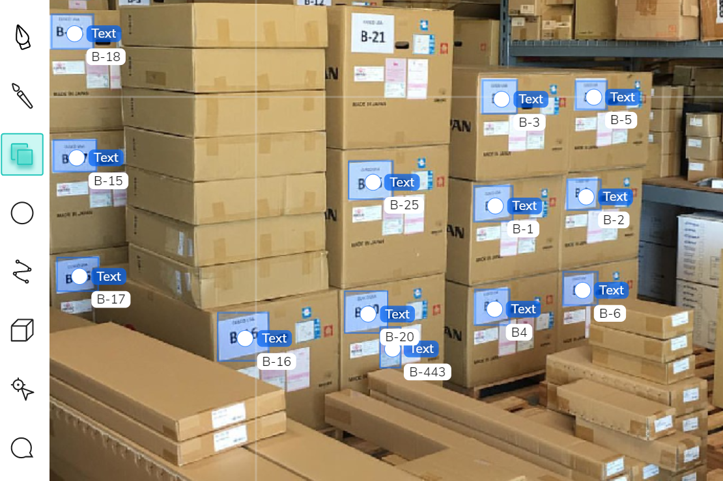

Detecting Anomalies In Factories
Missing pill in the manufacturing process
Checking the barcodes of the boxes

Slide 8
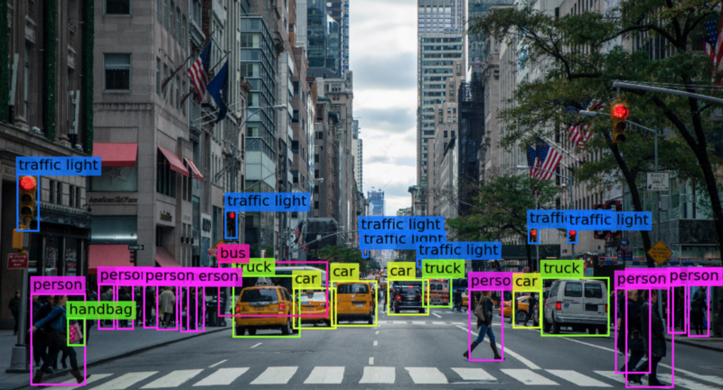
Self Driving Cars
Computer vision is being used in self-driving cars for detecting humans, and roads, checking road conditions and traffic light detection.

Slide 9
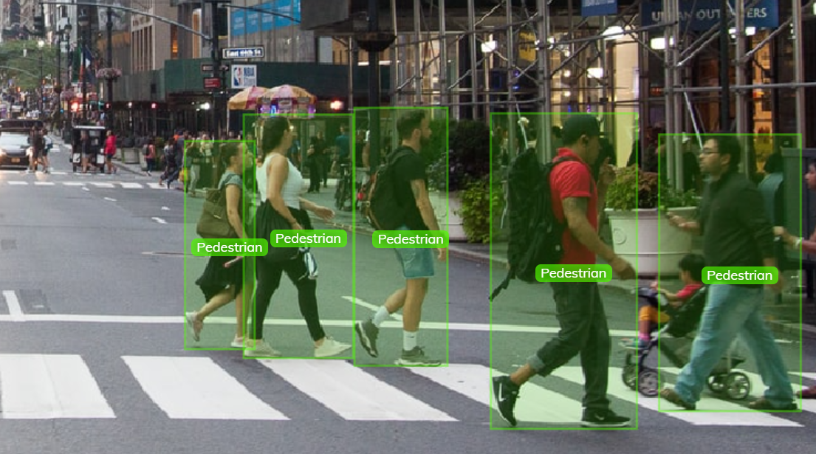
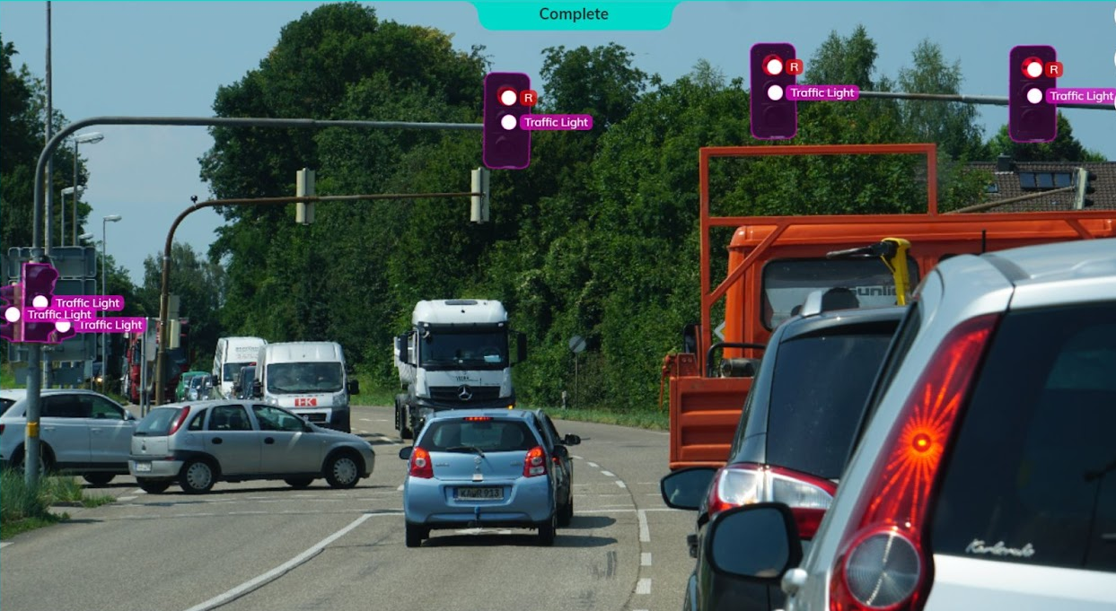
Detecting Humans and Traffic Lights

Slide 10
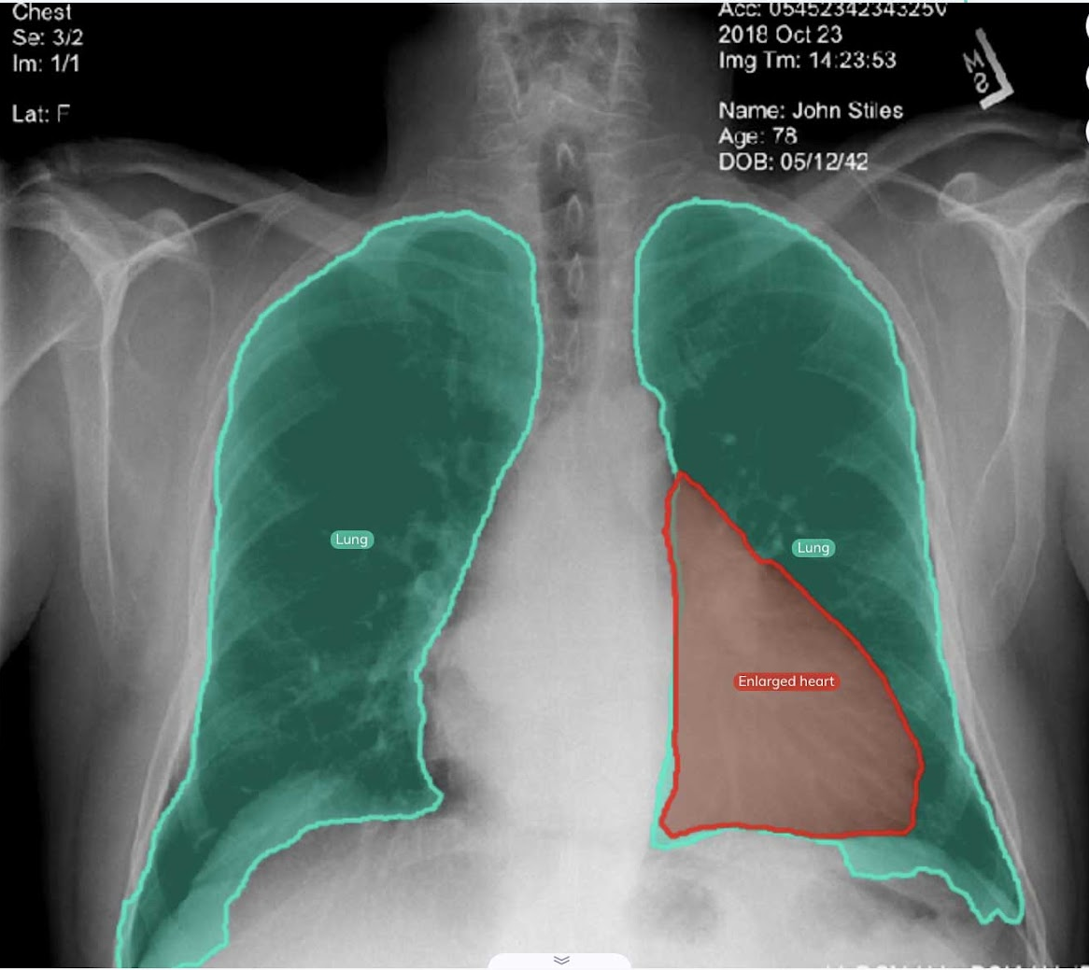
Medical Imaging
Computer vision is getting better and better over time in the healthcare industry
It is possible to use for detecting anomalies in the organs.

Slide 11
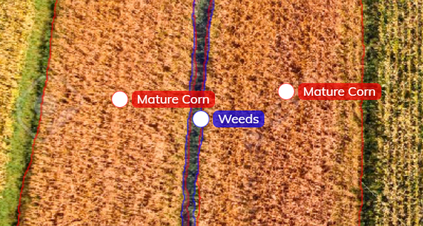
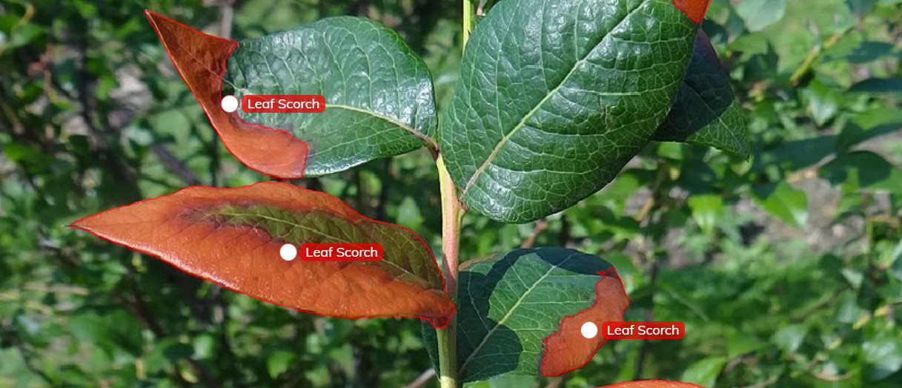
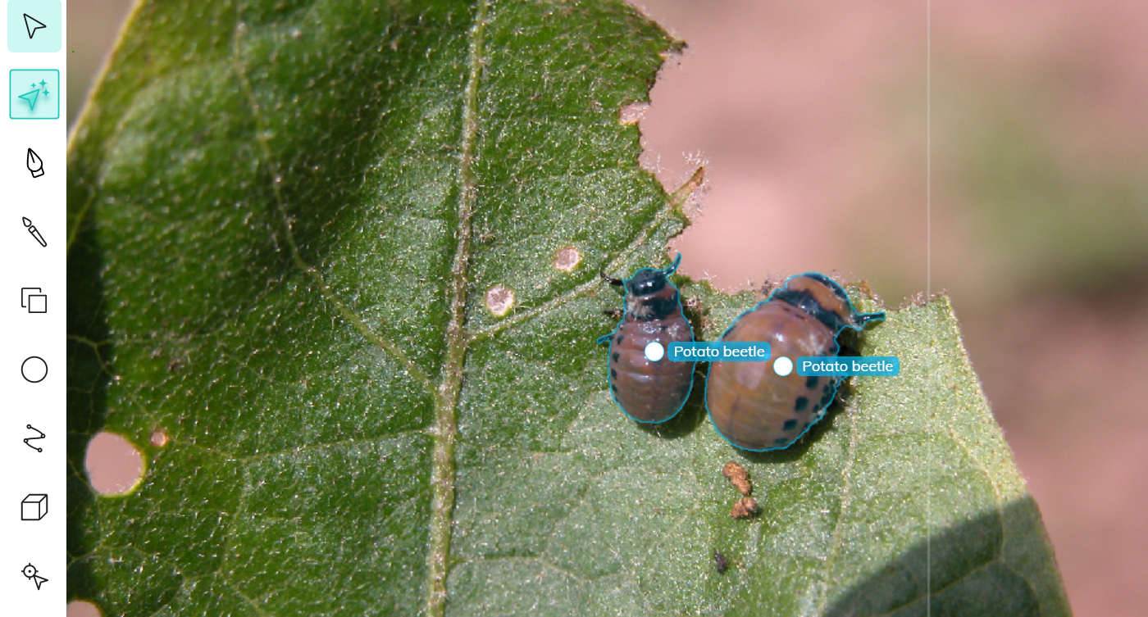
Agriculture
In the agriculture sector, computer vision is being used for detecting weeds, bugs, and infected plants.

Slide 12
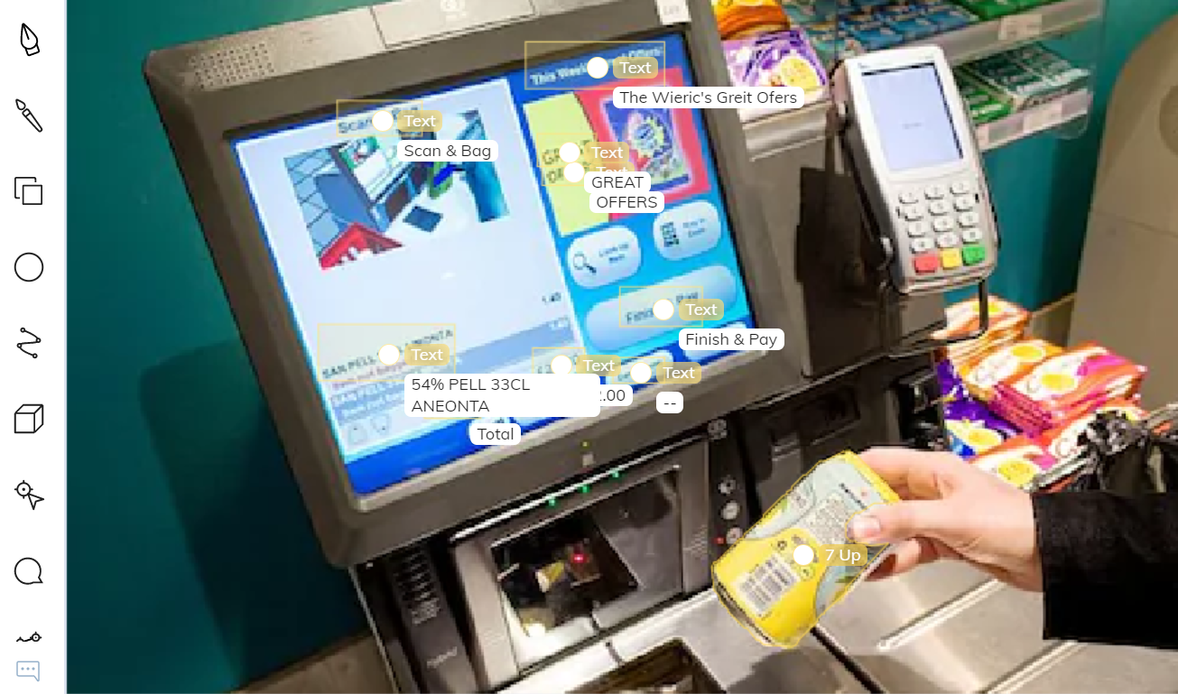
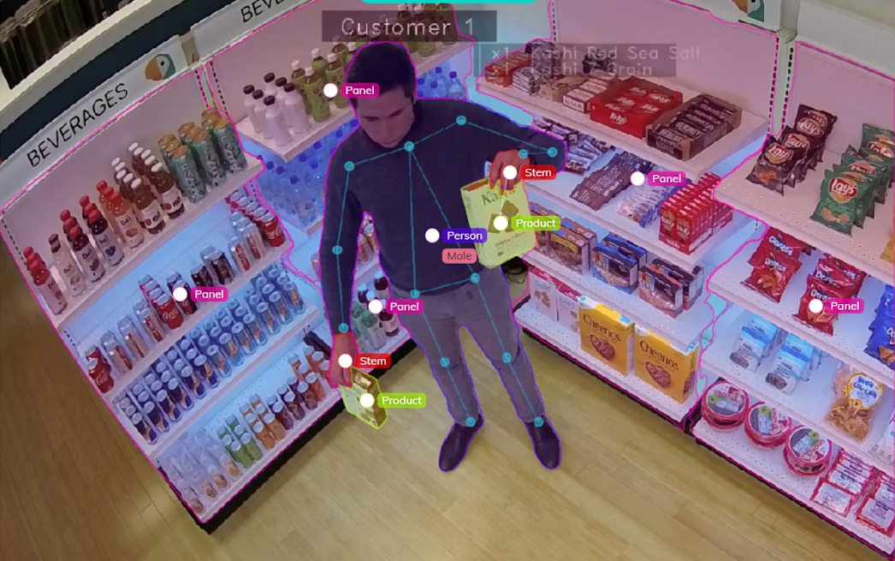
Retail
Computer vision is sometimes used for detecting suspicious activities from CCTV footage and it is
used for self-checkout.

Slide 13
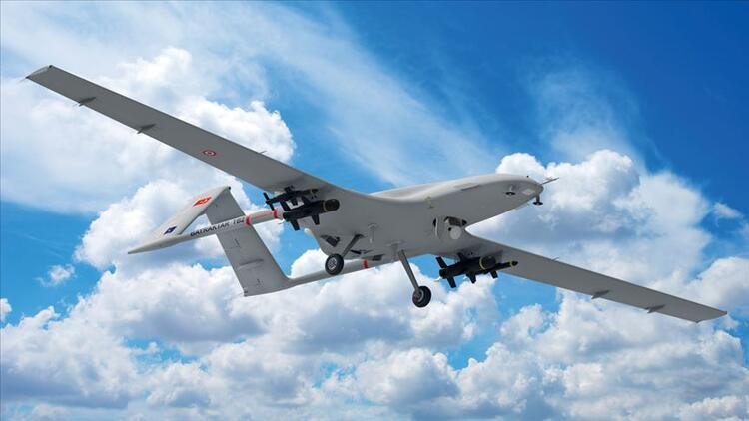
Military
One of AI’s most used sectors is the military sector.
Location and facial recognition
Turkish SIHA

Slide 14
Thank you for your time
Ahmet Enes Topçu 150210310
Alihan Esen 150220338
Bedirhan Öztürk 150210321
Emirhan Gazi 150220757
Tunahan Görgülü 150210311

Slide 15
References
https://cds.cern.ch/record/400313/files/p21
https://www.v7labs.com/blog/computer-vision-applications#h4
https://datafromsky.com/trafficdrone/
https://www.ibm.com/topics/computer-vision
https://i4.hurimg.com/i/hurriyet/75/750x422/5e5ca7c52269a21d1c05713a.jpg
https://pimages.toolbox.com/wp-content/uploads/2022/05/13121955/Human-Vision-vs.-Computer-Vision.png
https://miro.medium.com/max/1200/1*s9raSe9mLeSSuxE3API-ZA.gif
https://www.researchgate.net/profile/Kent-Stevens/publication/235626691/figure/fig1/AS:601593292541989@1520442426785/figure-fig1_Q320.jpg
https://media.wired.com/photos/5932a435aef9a462de98413c/master/pass/Lawrence-Roberts.jpg

